Slide 1

Scale
Creation
Todd Abraham
Iowa State University

Slide 2

Indicators and Indices
Indicator
An Item – A Single Piece of the Puzzle
Index
A Collection of Items – “Most” of the Puzzle
Organisation for Economic Co-operation and Development (OECD)
“A composite indicator is formed when individual indicators are compiled into a single index, on the basis of an underlying model of the multi-dimensional concept that is being measured.”

Slide 3
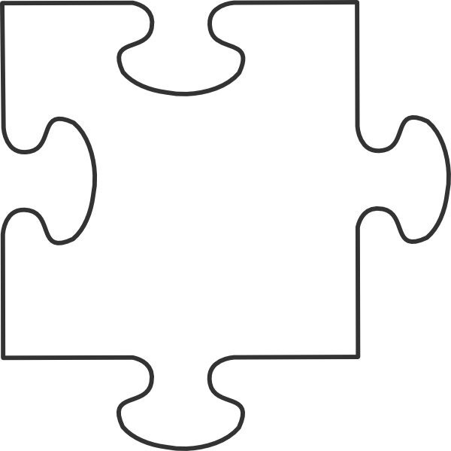
A Conceptual Example
Measuring Commuting to Work
Mileage
Time
Traffic Density
Average Speed
Method of Transportation
Cost
Aesthetic Value
Mileage
Time
Traffic Density
Average Speed
Method of Transportation
Cost
Aesthetic Value
What Other
Pieces of the
Puzzle?

Slide 4
Why Indices?
Better Measurement
Psychometrics and Classic Measurement Theory (Social Sciences)
Construct Coverage – Height vs. Well-being
Sensitivity - Variance
Consistency – Number of Items (smoothing)
Baking Thermometers
Basis in Theory
Unobservable Complex Constructs

Slide 5
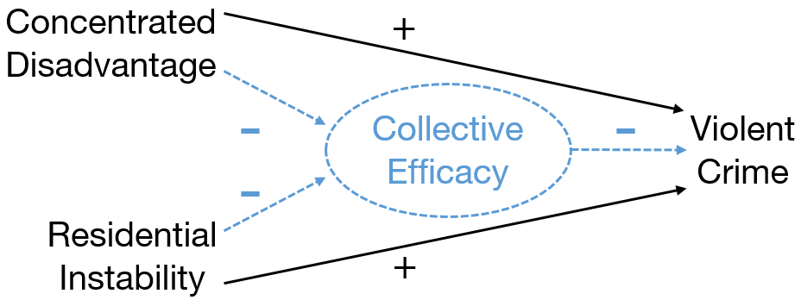
An Example
Collective Efficacy
Sampson, Raudenbush, & Earls (1997)

Slide 6
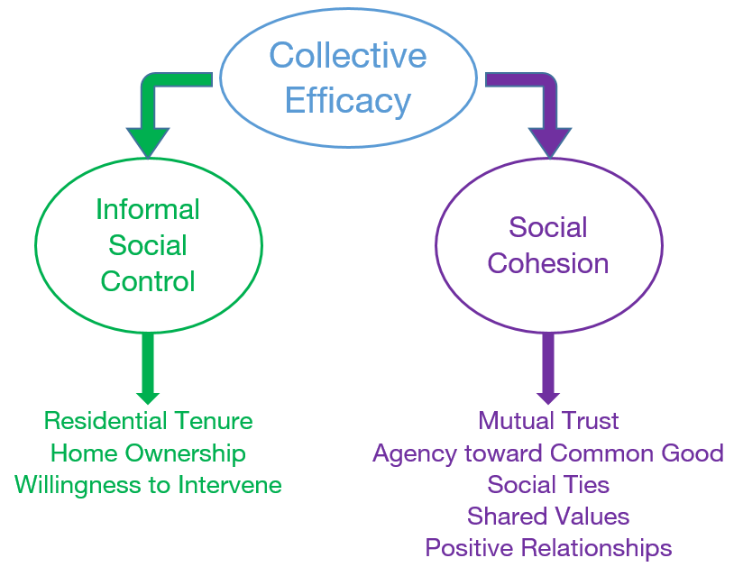
What is Collective Efficacy?
A Multidimensional Construct
Of Multidimensional Constructs!
Collections of Items
Theoretical Relationships

Slide 7
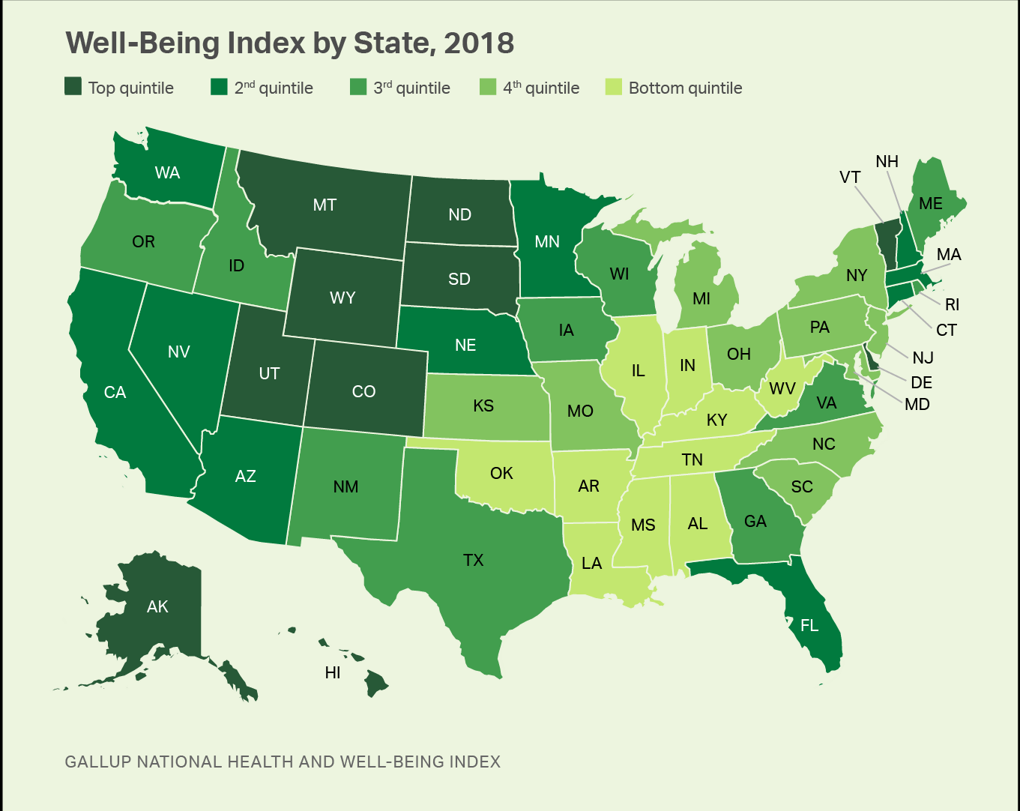
Indices Abound!
Index of Deep Disadvantage
Poverty Solutions Initiative: University of Michigan
Gallup/Sharecare Well-Being Index
Income
Poverty
Indicators
Health
Life Expectancy
Birth Weights
Social Mobility
Intra-generational
Mobility Indicators
Career Social Financial
Community Physical
Oglala Lakota County, South Dakota
Todd County, South Dakota
Claiborne County, Mississippi
Issaquena County, Mississippi
Holmes County, Mississippi
Buffalo County, South Dakota
Leflore County, Mississippi
East Carroll Parish, Louisiana
Coahoma County, Mississippi
Corson County, South Dakota

Slide 8
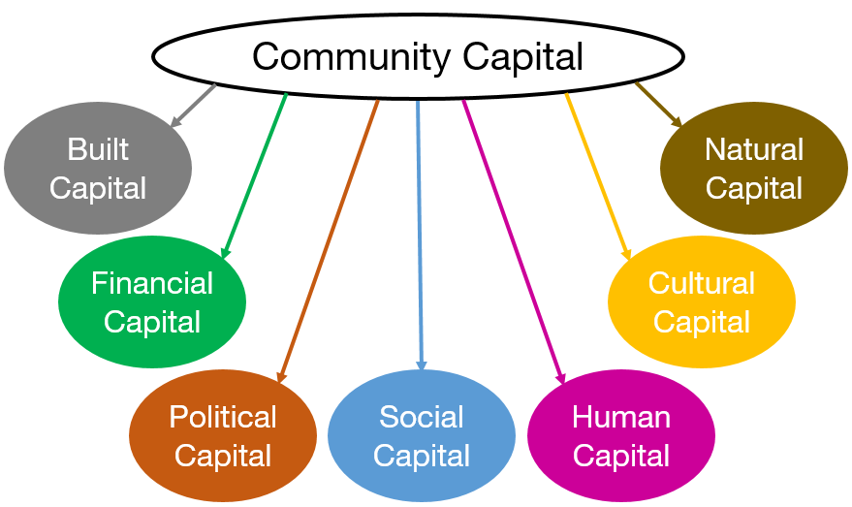
The Community Capitals Model
A Multidimensional Construct of Multidimensional Constructs!

Slide 9
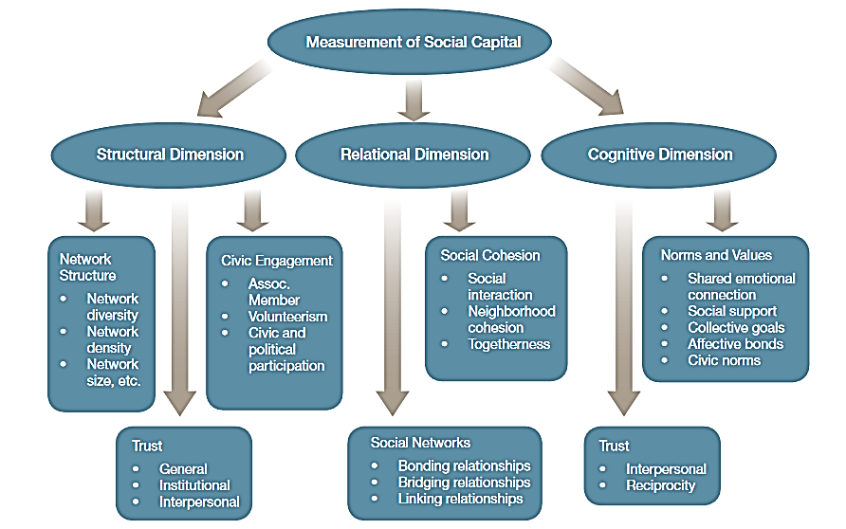
Social Capital
The NBS Model
Network Perspective
Acquaah, M., Amoako-Gyampah, K., & Gray, B., Nyathi, N. Q. 2014. Measuring and Valuing Social Capital: A Systematic Review. Network for Business Sustainability South Africa. Retrieved from: nbs.net/knowledge
Bonding
Social Group Ties
Similar Others
Bridging
Cross-Group Ties
Different Others
Linking
Institutional Ties
Hierarchical Others

Slide 10
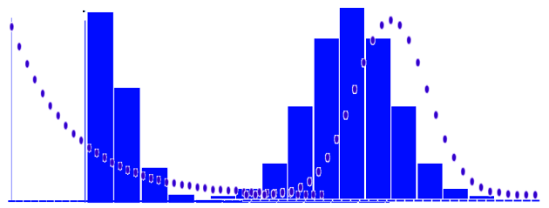
Constructing Indices
Scaling
Raw Metrics
Yes/No + Somewhat Likely + $36,217 = ?
Distributional Differences
Possible Solutions
Standardization (μ, σ)
N-tiles
http://gates.policy-analytics.net/

Slide 11
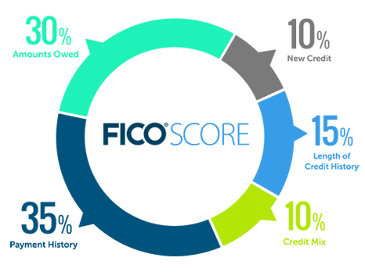
Constructing Indices (cont.)
Weighting
Unit Weighting (common)
1*item_{i} + 1*item_{j} + …
Differential Weighting
Usually Theory Driven (EuroQol)
Maybe Not Always
Optimal Weighting
Entirely Empirically Driven
Index of Deep Disadvantage (PCA); G/S Well-Being Index (FA)
https://www.myfico.com/credit-education/whats-in-your-credit-score

Slide 12
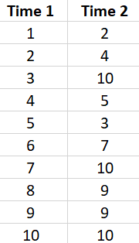
Evaluating Indices
Reliability
Measurement Consistency
Same (similar) Values each Assessment r = .71
Change can Occur but Rank is Maintained
Inter-indicator Agreement
Correlation – Indicators of Same Construct
Variance Partitioning
Total Score Variance / Total Variance in Items (R²)

Slide 13
Evaluating Indices (cont.)
Validity (Accuracy)
Reliability = Necessary but not Sufficient
Types of Validity
1) Content
2) Construct
a) Convergent
b) Divergent (Discriminant)
c) Concurrent
d) Predictive
3) Face
Evidence of Validity
1) Domain Coverage (subjective)
2) Construct Intended (objective)
a) Expected Relationships
b) Expected Non-Relationships
c) Relates to Criteria Now
d) Relates to New Criteria Later
3) “Looks Right” (stakeholders)

